Slide 1
Review
GR #2 next class:
7.1 Integration by Parts
7.4 Integration by Partial Fractions
7.8 Improper Integrals
6.4 Work
6.5 Average Value Function
8.3 Hydrostatic Force/Pressure
9.1 Differential Equations
9.2 Direction Fields
9.3 Separable Equations
9.4 Population Growth
11. Sequences
Webwork Set 2

Slide 2
Growth Review
In a certain part of Pike National Forest, dead pine needles accumulate on the ground at a rate of 8 kg/m^2 per year. They decompose at a rate of 80% per year. If there are 7 kg/m^2, how much will there be after 2 yrs?
Hints:
Rate = input – output
Each year, do we get rid of all the pin needles that fall on the ground?

Slide 3
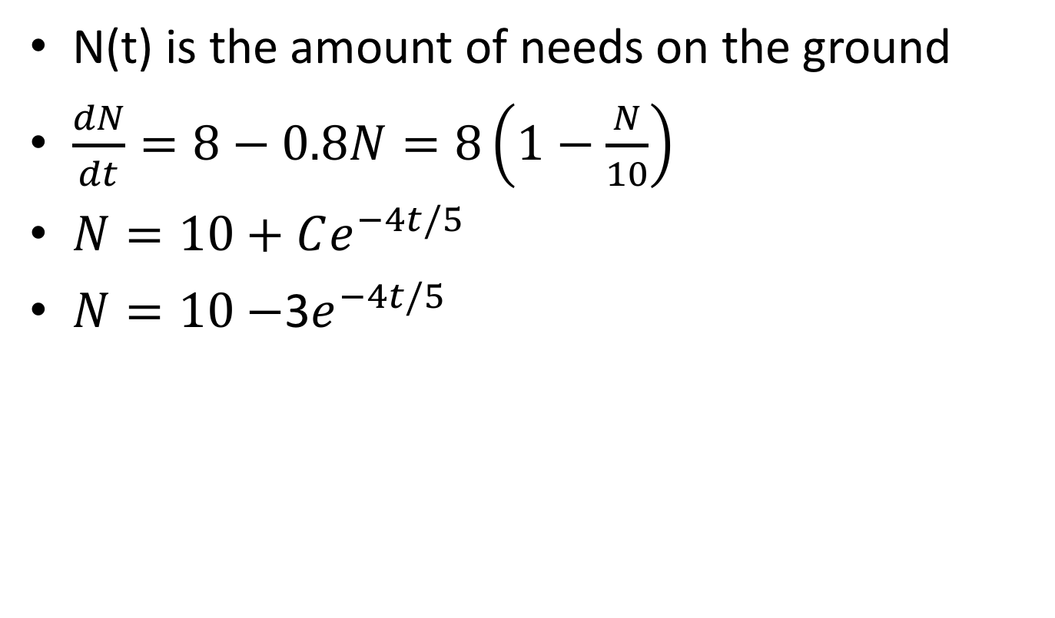
Solution
N(t) is the amount of needs on the ground
$\frac{dN}{dt}=8−0.8N=8\left(1−\frac{N}{10}\right)$
$N=10+Ce^{−4t/5}$
$N=10−$3$e^{−4t/5}$

Slide 4
Math 152 – Lesson 23
Lesson | Topic | Reading
22 | Models for Population Growth | 9.4
23 | Sequences | 11.1
24 | GR
Objectives:
Explain what it means for a sequence to converge or diverge
Explain & compute the limit of a convergent sequence
List terms of a sequence (including recursive sequences)

Slide 5
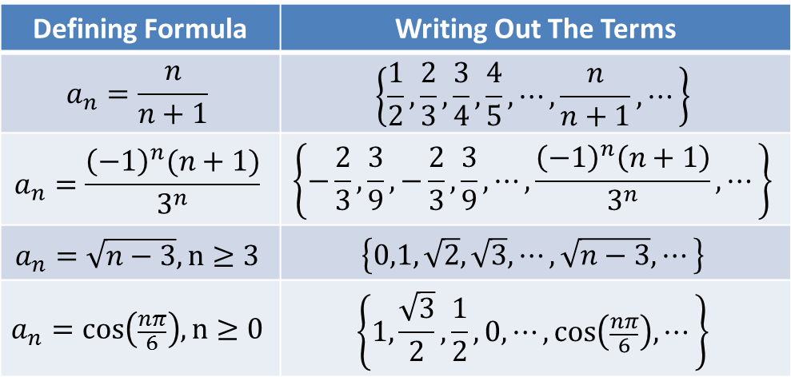
Defining a Sequence
Many sequences can be defined by giving a formula for the nth term.
Defining Formula | Writing Out The Terms
$$a_{n}=\frac{n}{n+1}$$ | $$\left\{\frac{1}{2},\frac{2}{3},\frac{3}{4},\frac{4}{5},⋯,\frac{n}{n+1},⋯\right\}$$
$$a_{n}=\frac{{\left(−1\right)}^{n}(n+1)}{3^{n}}$$ | $$\left\{−\frac{2}{3}, \frac{3}{9},−\frac{2}{3}, \frac{3}{9},⋯,\frac{{\left(−1\right)}^{n}\left(n+1\right)}{3^{n}},⋯\right\}$$
$$a_{n}=\sqrt{n−3}, n≥3$$ | $$\left\{0,1,\sqrt{2},\sqrt{3},⋯,\sqrt{n−3},⋯\right\}$$
$$a_{n}=\cos\left(\frac{nπ}{6}\right),n≥0$$ | $$\left\{1,\frac{\sqrt{3}}{2},\frac{1}{2},0,⋯,\cos\left(\frac{nπ}{6}\right),⋯\right\}$$
Notes:
Stewart 11.1
“a list of numbers written in a definite order” 11.2, a “series” would be the summation of the list of numbers
“for every positive integer, n, there is a corresponding number $a_{n}$”
thus “a sequence can be defined as a function whose domain is the set of positive integers”
n = “the index” of the terms
List first five terms of 3^n/ (1+2^n)
A(n+1)=an/n
5, 8, 11, 14, 17, …

Slide 6
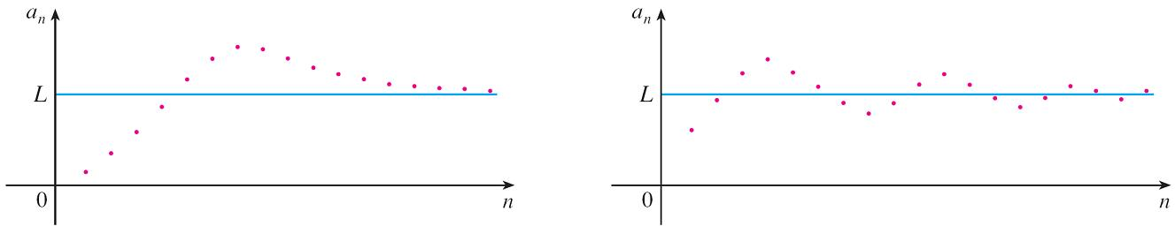

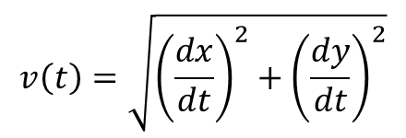
Limit of a Sequence
If a sequence {a_{n}} has the limit L then we can write
$\lim_{n→∞}{a_{n}}=L,$ or, $a_{n}→L as n→∞$
If $\lim_{n→∞}{a_{n}}$ exists, we say the sequence converges (or is convergent).
Otherwise, we say the sequence diverges (or is divergent).
Example: The sequence {a^{n}} is convergent if $−1<a≤1$ and divergent for all other values of a.
$$\lim_{n→∞}{a^{n}}=\left\{\begin{aligned}0, −1<a<1 \\ &1, a=1\end{aligned}\right.$$
Notes:
Talk about tail behavior…looking at the limit as n approaches infinity.
Definition 2.6.7, Stewart, p 137…just replace $a_{n}$ with f(x)

Slide 7
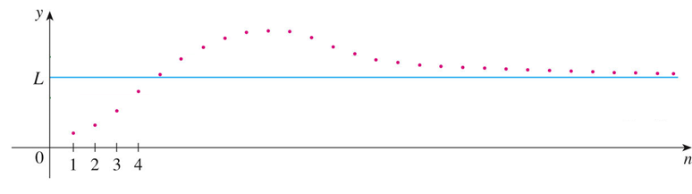
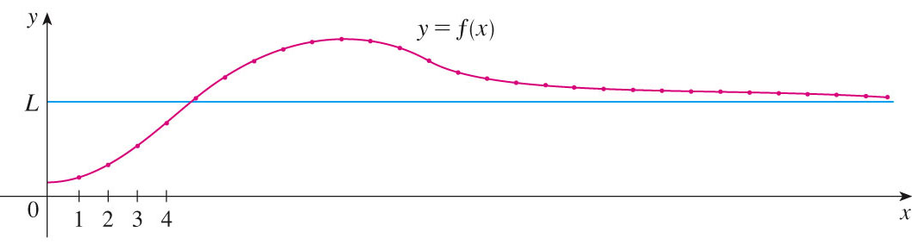
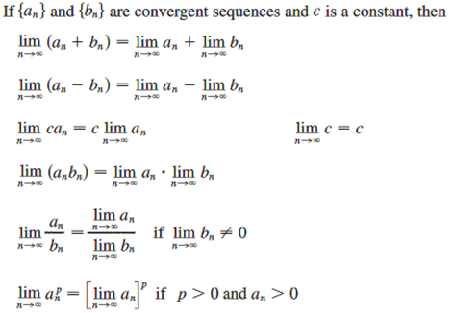
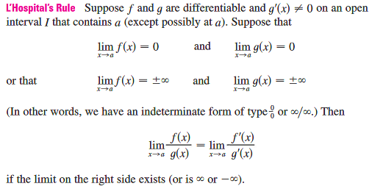
Finding Limits of Convergent Sequences
If integers a_{n} follow f(x), then you can use f(x) to find the limit of the sequence a_{n}
Notes:
P693, and p99

Slide 8
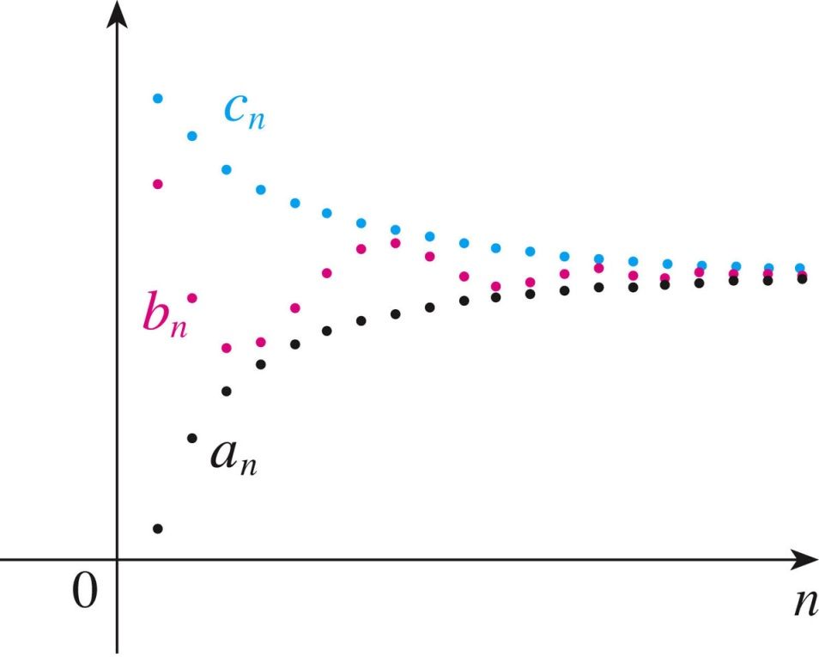
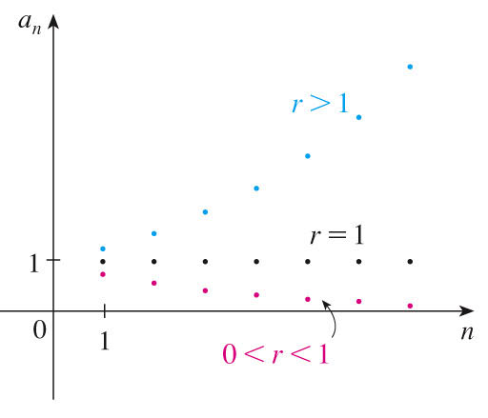



Finding Limits of Convergent Sequences
$$a_{n}={\left(r\right)}^{n}$$
Notes:
P696, a sequence is monotonic if it is EITHER increasing or decreasing

Slide 9
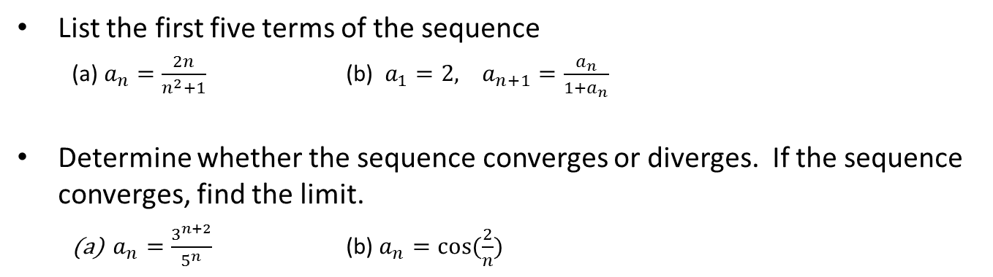
Board Work
List the first five terms of the sequence
(a) $a_{n}=\frac{2n}{n^{2}+1}$ (b) $a_{1}=2, a_{n+1}=\frac{a_{n}}{1+a_{n}}$
Determine whether the sequence converges or diverges. If the sequence converges, find the limit.
$a_{n}=\frac{3^{n+2}}{5^{n}}$ (b) $a_{n}=\cos{(\frac{2}{n})}$
Notes:
b) “recursively” defined…like a Fibonacci sequence – 112358…1+1=2, 1+2=3, 2+3=5, 3+5=8…

Slide 10

Desk Work
1. Converge or diverge
(a) $\lim_{n→0}{\frac{\sin{(0.1πn)}}{0.1πn}}$ (b) $\lim_{n→∞}{\ln{\frac{x^{2}}{x}}}$ (c) $\lim_{n→∞}{\frac{n}{n+1}}$ (d) $\lim_{n→∞}{{(−1)}^{n}sin⁡(\frac{1}{n})}$
Solutions:
(a) Converge to 1 (b) Converge to 0 (c) Converge to 1 (d) Converges to 0

Slide 11
Backups

Slide 12
11.1 HW
Notes:
17) (-1)^(n-1)*(n^2/(n+1))
25) Divide top&btm by highest power of n – n^2) – then take the limit as n approaches infinity = 5/1 = 5

